Slide 1
Week 1
Entity Relationship Diagrams – CROWS FEET NOTATION – Part 7

Slide 2
Student Objectives
Upon completion of this video, you should be able to:
Use the new notation, Crow’s Feet Notation, to create an ER Diagram.

Slide 3
Newer Notation – Crow’s Foot Notation - ENTITIES
Patient
Instead of this:
Do this:
OHIPNum
LastName
FirstName
Patient
OHIPNum
FirstName
LastName

Slide 4
Crow’s Foot Notation - RELATIONSHIPS
Relationship indicated with just a line
End of the line indicates the cardinality AND the participation:
Zero or more
One or more
One and only one
Zero or 1

Slide 5




Examples
One to One →
One to Many →
Many to Many →
One to Many →
Question: What is the participation on each example?

Slide 6
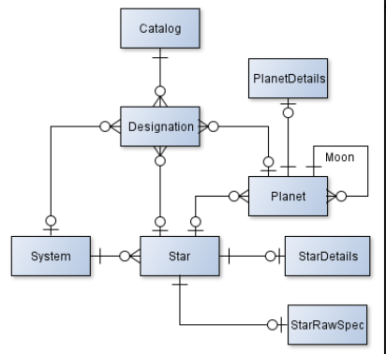
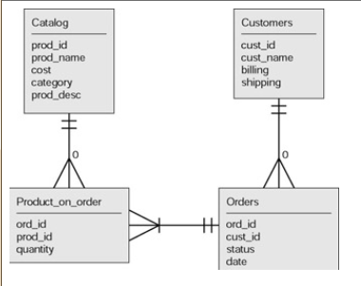
More examples
Video Description

Slide 7
QUESTION: Draw the ER diagram for the following using Crow’s Foot Notation
Entities:
Customer (customers may have never purchased from us before)
Movie (movies we have in our system)
Copy of DVD (actual DVD someone rents)
Show the relationships: currently renting, and is a
ANSWER:
CUSTOMER
CustomerID
FirstName
LastName
DVDCOPY
DVDID
HomeStore
MOVIE
MovieID
Title
Year
Currently renting
Is a

